Slide 1
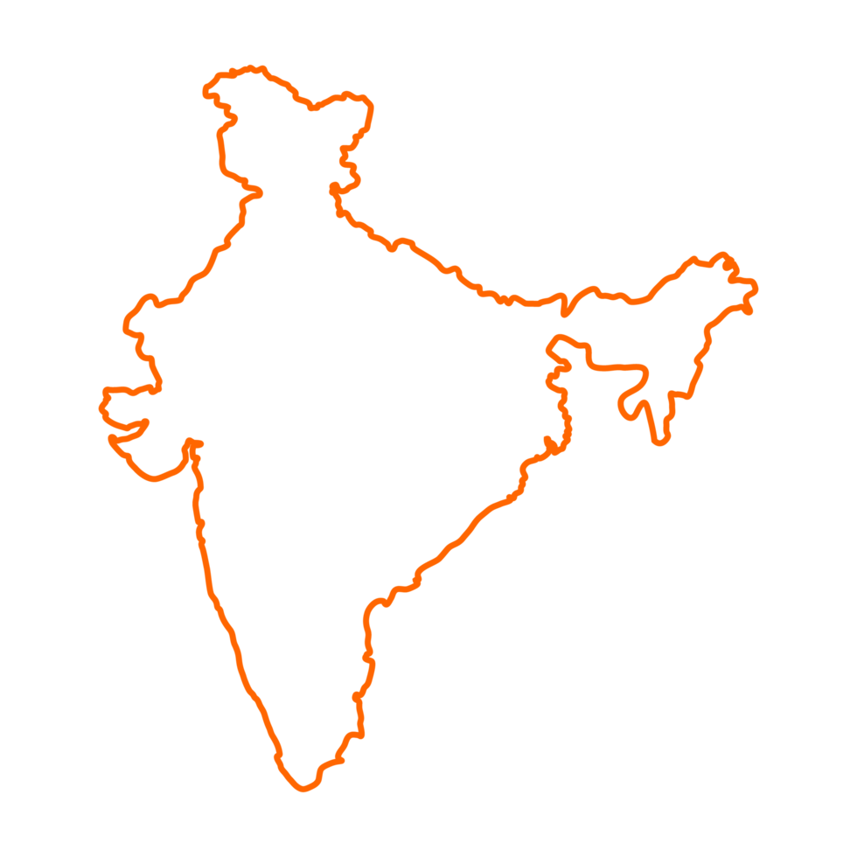

Analysis of Air Quality and Forecasting
Submitted by:
Himanshu Samal - 240343025018
Pritam Nimbalkar - 240343025038
Ritul Tayade - 240343025042
Shalu Sharma - 240343025045

Slide 2

Contents:
1
Problem Statement
7
Models Deployed
2
Data Description
8
Air Quality Forecasting
3
Technologies Implemented
9
Insights Boards
4
Workflow
10
Future Scope
5
Inference derived
11
Conclusions
6
Preprocessing

Slide 3


Problem Statement
1. Affects of the pollution on Rapidly developing countries like India.
2. Many Indian cities suffer worsening air quality despite control measures.
3. Millions of residents are impacted by poor air quality.
4. Understanding trends in air pollution levels is crucial for effective policy implementation.
5. Evaluating the effectiveness of pollution control measures is necessary.
6. Machine learning (ML) can analyze complex datasets to uncover patterns and make predictions.
7. Data driven insights can aid policy decisions and public health strategies.

Slide 4

Data Description
Data Description
1. The dataset contains air quality data for Indian cities from the year 2010 to 2023.
2. It provides information about the air quality conditions in 453 cities across India.
3. The data has been collected from the Central Control Room for Air Quality Management,
which indicates that it is a reliable and authoritative source.

Slide 5




Technology Implemented
Machine
Learning

Slide 6

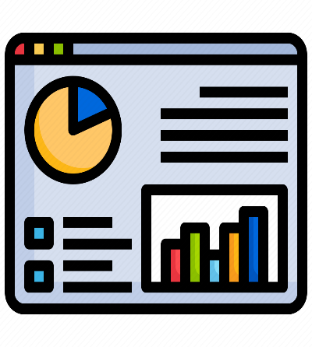

Workflow
Dataset
Data Cleaning
Data Visualization
Hive
Machine Learning
Pre-processing

Slide 7

Inference
Derived

Slide 8
T

Slide 9
Preprocessing
Data Cleaning:
Handling Missing Values: Techniques for filling in or interpolating missing data.
Outlier Detection: Identifying and managing anomalies in the data.
Feature Scaling:
Normalization or Standardization: Scaling features to ensure they contribute equally to model performance.
Data Transformation:
Temporal Aggregation: Aggregating data into daily, weekly, or monthly summaries.
Feature Engineering: Creating new features based on existing data, such as pollution indices or combined meteorological factors.
Data Splitting
Training and Testing Sets: Dividing the data into training and testing sets for model evaluation.

Slide 10

Models Deployed

Slide 11
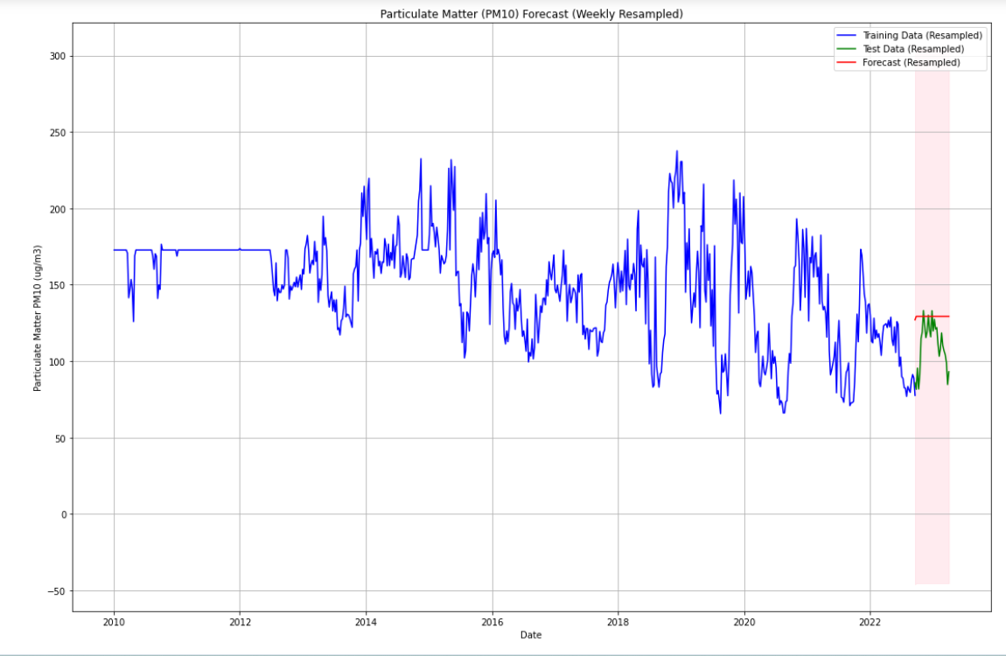
ARIMA
The ARIMA (AutoRegressive Integrated Moving Average) model is a powerful statistical technique used for analyzing and forecasting time-series data.
One major disadvantage is its limited ability to capture long-term trends and seasonal variations, particularly in highly dynamic and nonlinear weather systems.
RMSE =

Slide 12
SARIMA
SARIMAX (Seasonal Autoregressive Integrated Moving Average with external factors) is a popular time series forecasting model that extends ARIMA by incorporating seasonal components and exogenous variables. It is particularly effective for capturing complex seasonal patterns
RMSE =

Slide 13
Air Quality Forecasting

Slide 14
Insights Boards

Slide 15
Future Scope
Enhanced Machine Learning Models: Explore advanced machine learning algorithms and models to further improve prediction accuracy and robustness. Investigate deep learning approaches to capture intricate patterns in the meteorological data.
Real-time Data Processing: Integrate real-time data processing capabilities to provide users with the most up-to-date information. This could involve adopting streaming analytics technologies and continuous model training.
Integration with Additional Data Sources: Expand the project's scope by integrating data from additional sources, such as satellite imagery or other meteorological databases. This diversification could lead to a more comprehensive understanding of environmental conditions.

Slide 16
Conclusion
Our project represents a sophisticated and comprehensive system for predicting and analyzing meteorological data across 400+ cities in India.
The integration of Python, PySpark, MongoDB, Kaggle and Tableau Public facilitated a robust and scalable infrastructure for data retrieval, preprocessing, machine learning modeling, and user interaction.
Our findings provide a foundation for developing targeted strategies and policies aimed at improving air quality and ensuring a healthier environment.

